Slide 1
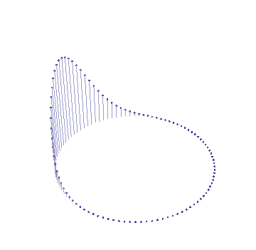
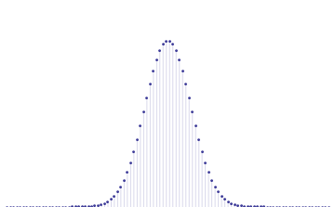
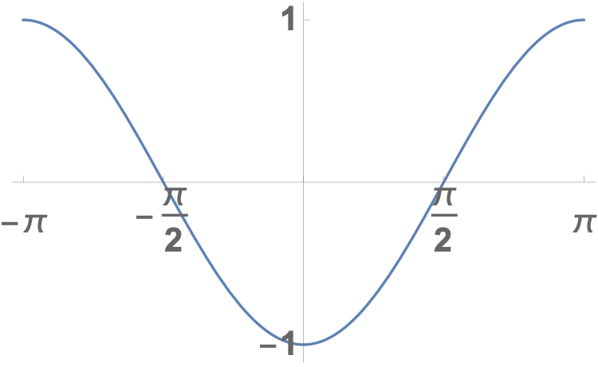
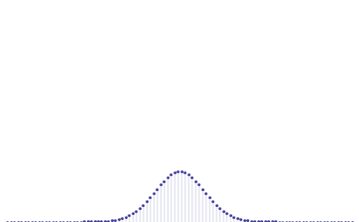
Real time evolution example
Gaussian wave packet with momentum
$$k_{0}=0$$
$$E_{k}$$
$$k$$
Gaussian wave packet with momentum
$$k_{0}=π/2$$
$$E_{k}$$
$$k$$

